Slide 1
S O F T W A R E E N G I N E E R I N G A N D P R O J E C T M A N A G E M E N T

Slide 2
C O U R S E O B J E C T I V E S
To introduce the fundamental concepts of software engineering.
To build an understanding on various phases of software development.
To introduce various software process models/life cycle model

Slide 3
M O D U L E - I
1.1 INTRODUCTION TO SOFTWARE ENGINEERING
1.1.1 Need of Software Engineering
1.1.2 Characteristics of Good Software
1.1.3 Three parties are involved in software engineering
1.1.4 Types of software
1.1.5 Qualities / Skills Possessed By A Good Software Engineer
1. 2 SCOPE OF SOFTWARE ENGINEERING
1.2.1 Historical aspects
1.2.2 Economic aspects
1.2.3 Maintenance aspects
1.2.4 Specification and design aspects
1.2.5 Team programming/development aspects
1. 3 SOFTWARE ENGINEERING A LAYERED TECHNOLOGY
1.3.1 Processes
1.3.2 Methods
1.3.3 Tools
1. 4 SOFTWARE PROCESS MODELS
1.4.1 Classical waterfall model
1.4.2 Iterative waterfall model
1.4.3 Prototyping models
1.4.4 Incremental models
1.4.5 Spiral model

Slide 4
1.1 I N T R O D U C T I O N T O S O F T W A R E E N G I N E E R I N G
Software is more than just a program code.
A program is an executable code, which serves some computational purpose.
Software is considered to be a collection of executable programming code, associated libraries and documentations.
Software, when made for a specific requirement is called software product

Slide 5
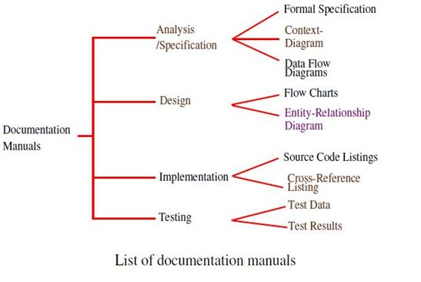
D O C U M E N T A T I O N M A N U A L S

Slide 6
I N T R O D U C T I O N T O S O F T W A R E E N G I N E E R I N G
ENGINEERING
Application of science, tools and methods to find cost effective solution to problems
SOFTWARE ENGINEERING
The application of a systematic, disciplined, quantifiable approach to the development, operation and maintenance of software

Slide 7
I N T R O D U C T I O N T O S O F T W A R E E N G I N E E R I N G
The outcome of software engineering is an efficient and reliable software product.
IEEE defines software engineering as:
The application of a systematic, disciplined, quantifiable approach to the development, operation and maintenance of software

Slide 8
I N T R O D U C T I O N T O S O F T W A R E E N G I N E E R I N G
Software engineering principles use two important techniques to reduce problem complexity:
Abstraction
Decomposition

Slide 9
ABSTRACTION
The principle of abstraction implies that a problem can be simplified by omitting irrelevant details.
In other words, the main purpose of abstraction is to consider only those aspects of the problem that are relevant for certain purpose and suppress other aspects that are not relevant for the given purpose.
Once the simpler problem is solved, then the omitted details can be taken into consideration to solve the next lower level abstraction, and so on.
Abstraction is a powerful way of reducing the complexity of the problem.

Slide 10
DECOMPOSITION
In this technique, a complex problem is divided into several smaller problems and then the smaller problems are solved one by one.
The problem has to be decomposed such that each component of the decomposed problem can be solved independently and then the solution of the different components can be combined to get the full solution.

Slide 11
DECOMPOSITION [2]
A good decomposition of a problem should minimize interactions among various components.
If the different subcomponents are interrelated, then the different components cannot be solved separately and the desired reduction in complexity will not be realized.

Slide 12
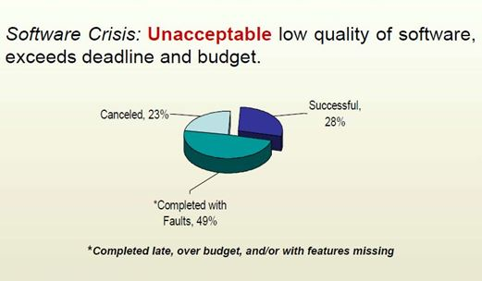
W H Y T H E N E E D O F S O F T W A R E E N G I N E E R I N G

Slide 13
S O F T W A R E C R I S I S
Software crisis means some problem that occur while designing software
It is a term used in early days of computing science for the difficulty of writing useful and efficient program in required time

Slide 14
C A U S E S O F S O F T W A R E C R I S I S
Project running over budget
Project running over time
Software was very in efficient
Software of low quality
Software often didn’t meet requirements

Slide 15
W H Y T H E N E E D O F S O F T W A R E E N G I N E E R I N G
There are still many reports of software projects going wrong and ‘software failures’.
Software engineering is criticized as inadequate for modern software development.

Slide 16
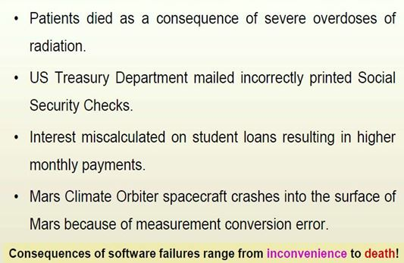
H O R R O R S O F T W A R E F A I L U R E S T O R I E S

Slide 17
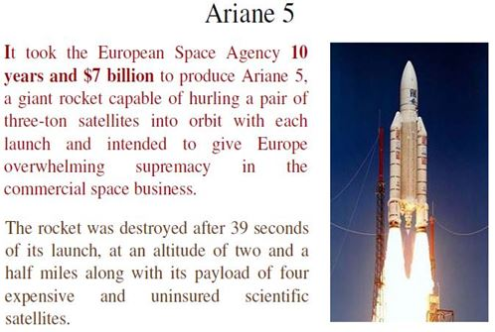
S O M E S O F T W A R E F A I L U R E
It turned out that the cause of the failure was a software error in the inertial reference system.

Slide 18
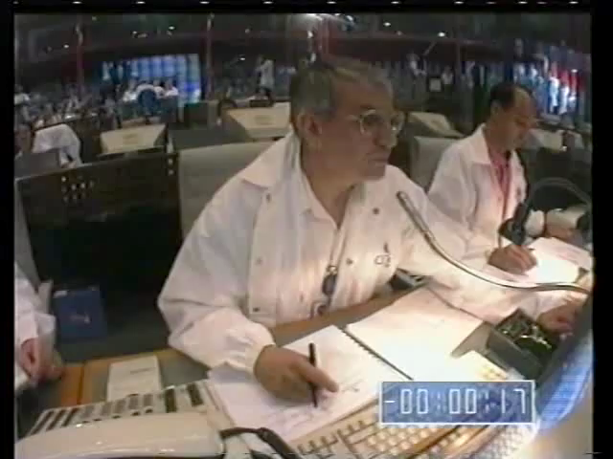
A R I A N E 5 C R A S H

Slide 19
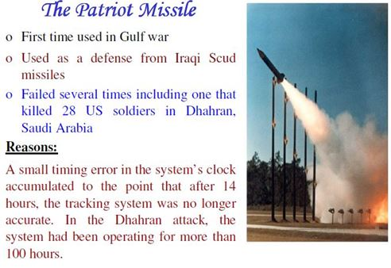
S O M E S O F T W A R E F A I L U R E

Slide 20

T H E P A T R I O T M I S S I L E

Slide 21
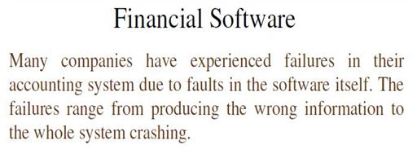
S O M E S O F T W A R E F A I L U R E

Slide 22
1.1.2 C H A R A C T E R I S T I C S O F G O O D S O F T W A R E
A software product can be judged by what it offers and how well it can be used.
This software must satisfy on the following grounds:
Operational
Transitional
Maintenance

Slide 23
OPERATIONAL
This tells us how well software works in operations.
It can be measured on:
Budget
Usability
Efficiency
Correctness
Functionality
Dependability
Security
Safety

Slide 24
TRANSITIONAL
This aspect is important when the software is moved from one platform to another:
Portability
Interoperability
Reusability
Adaptability

Slide 25
MAINTENANCE
This aspect briefs about how well a software has the capabilities to maintain itself in the ever-changing environment:
Modularity
Maintainability
Flexibility
Scalability

Slide 26
1.1.3 T H R E E P A R T I E S A R E I N V O L V E D I N S O F T W A R E E N G I N E E R I N G
CLIENT/CUSTOMER
The client/customer is the individual who wants a product to be built (developed).
DEVELOPERS
The developers are the members of a team responsible for building that product.
USER
The user is the person or persons on whose behalf the client has commissioned the product and who will utilize the software.

Slide 27
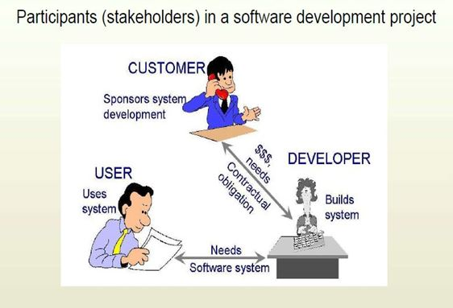
T H R E E P A R T I E S A R E I N V O L V E D I N S O F T W A R E E N G I N E E R I N G [2]

Slide 28
1.1.4 T Y P E S O F S O F T W A R E
[a] Based on parties relationship:
Internal Software
Both the client and developers may be part of the same organization.
Contract Software
The client and developers are members of totally independent organizations.

Slide 29
T Y P E S O F S O F T W A R E [2]
[b] Based on the functionality
Custom software
It is written for one client.
Commercial off-the-shelf (COTS) software
It has multiple copies and the copies are sold at much lower prices to a large number of buyers. It is developed for “the market”.
Open-source software
It is developed and maintained by a team of volunteers and may be downloaded and used free of charge by anyone.

Slide 30
1.1.5 Q U A L I T I E S / S K I L L S P O S S E S S E D B Y A G O O D S O F T W A R E E N G I N E E R
General Skill
(Analytical skill, Problem solving skill, Group work skill)
Programming Skill
(Programming language , Data structure , Algorithm , Tools( Compiler, Debugger))
Communication skill
(Verbal , Written, Presentation)
Design Skill
(s/w engineer must be familiar with several application domain)

Slide 31
1.2 S C O P E O F S O F T W A R E E N G I N E E R I N G
The scope of software engineering is extremely broad. In general, five aspects are involved:
Historical Aspects
Economic Aspects
Maintenance Aspects
Requirements, Analysis, and Design Aspects
Team Development Aspects

Slide 32
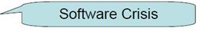
H I S T O R I C A L A S P E C T S
Software engineering cannot be considered as engineered since an unacceptably large proportion of software products still are being:
Delivered late
Over budget
With residual faults
Solution: A software engineer has to acquire a broad range of skills, both technical and managerial.
These skills have to be applied to: Programming; and Every step of software production, from requirements to post-delivery maintenance.

Slide 33
E C O N O M I C A S P E C T S
Applying economic principles to software engineering requires the client to choose techniques that reduce long-term costs in terms of the economic sense.
The cost of introducing new technology into an organization includes:
Training cost
Unable to do productive work when attending the class.

Slide 34
M A I N T E N A N C E A S P E C T S
Classical View of Maintenance:
Development-then-maintenance model.
But this model is unrealistic due to:
During the development, the client’s requirements may change. This leads to the changes in the specification and design.
Developers try to reuse parts of existing software products in the software product to be constructed.

Slide 35
M A I N T E N A N C E A S P E C T S
Modern view of Maintenance:
It is the process that occurs when “software undergoes modifications to code and associated documentation due to a problem or the need for improvement or adaptation”.
That is, maintenance occurs whenever a fault is fixed or the requirements change, irrespective of whether this takes place before or after installation of the product,

Slide 36
R E Q U I R E M E N T S , A N A L Y S I S A N D D E S I G N A S P E C T S
The earlier we correct a fault, the better. That is, the cost of correcting a fault increases steeply since it is directly related to what has to be done to correct a fault.
If the mistake is made while eliciting the requirements, the resulting fault will probably also appear in the specifications, the design, and the code.
It is crucial to check that making the change has not created a new problem elsewhere in the product. All the relevant documentation, including manuals, needs to be updated.
The corrected product must be delivered and reinstalled.

Slide 37
T E A M D E V E L O P M E N T A S P E C T S
Team development leads to interface problems among code components and communication problems among team members.
Unless the team is properly organized, an inordinate amount of time can be wasted in conferences between team members.
It also includes human aspects, such as team organization, economic aspects, and legal aspects, such as copyright law.

Slide 38
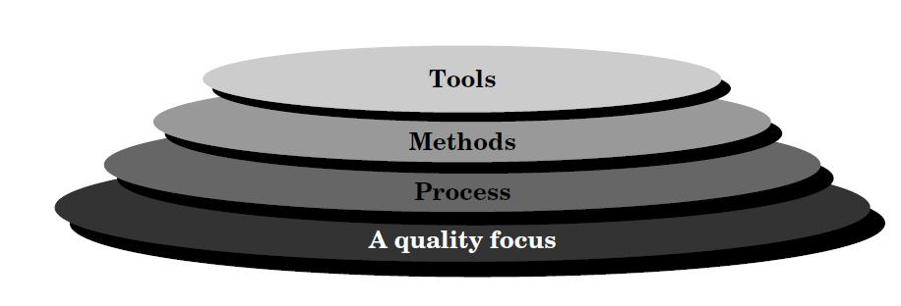
S O F T W A R E E N G I N E E R I N G A L A Y E R E D T E C H N O L O G Y
Fig : Software engineering layers

Slide 39
S O F T W A R E E N G I N E E R I N G A L A Y E R E D T E C H N O L O G Y
A quality Focus :
Any engineering approach must rest on an quality.
The "Bed Rock" that supports software Engineering is Quality Focus.
Process :
Foundation for Software Engineering is the Process Layer
Software Engineering process is the GLUE that holds all the technology layers together and enables the timely development of computer software.
It forms the base for management control of software project.

Slide 40
S O F T W A R E E N G I N E E R I N G A L A Y E R E D T E C H N O L O G Y
Methods:
Software Engineering methods provide the "Technical Questions" for building Software.
Methods contain a broad array of tasks that include communication requirement analysis, design modeling, program construction testing and support.
Tools:
Software engineering tools provide automated or semi-automated support for the "Process" and the "Methods".
Tools are integrated so that information created by one tool can be used by another.
Eg: CASE tools

Slide 41
S O F T W A R E P R O C E S S M O D E L S [ 1 ]
A software life cycle model (also called process model) is a descriptive and diagrammatic representation of the software life cycle
Many life cycle models have been proposed so far.
Each of them has some advantages as well as some disadvantages.

Slide 42
S O F T W A R E P R O C E S S M O D E L S [2]
A few important and commonly used life cycle models are as follows:
Classical Waterfall Model
Iterative Waterfall Model
Prototyping Model
Incremental Model
Spiral Model

Slide 43
C L A S S I C A L W A T E R F A L L M O D E L [ 1 ]
The classical waterfall model is easy to understand the most obvious way to develop software.
It is not a practical model in the sense that it cannot be used in actual software development projects.
Thus, this model can be considered to be a theoretical way of developing software

Slide 44
C L A S S I C A L W A T E R F A L L M O D E L [ 2 ]
FEATURES
The waterfall model is a sequential approach,
where each fundamental activity of a process represented as a separate phase, arranged in linear order.
Waterfall model is called plan-driven process,
Plan-driven process is a process where all the activities are planned first, and the progress is measured against the plan

Slide 45
C L A S S I C A L W A T E R F A L L M O D E L [ 3 ]
FEATURES
Result of each phase is one or more documents that are approved
Following phases will not start until the previous phase has finished
Output of one phase is fed as the input to the next phase

Slide 46
C L A S S I C A L W A T E R F A L L M O D E L [ 4 ]
Classical waterfall model divides the life cycle into the following phases as shown
Feasibility Study
Requirements Analysis and Specification
Design
Coding and Unit Testing
Integration and System Testing
Maintenance

Slide 47
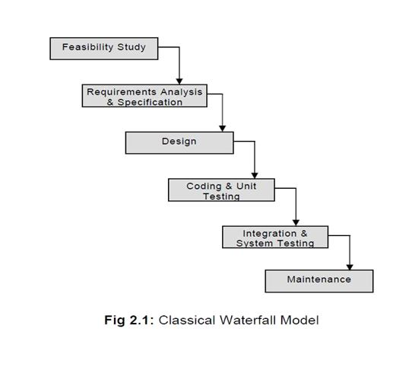
C L A S S I C A L W A T E R F A L L M O D E L [ 5 ]

Slide 48
F E A S I B I L I T Y S T U D Y
The main aim of feasibility study is to :-
determine whether development of s/w product is financially and technically feasible
Financial feasibility
Determine whether project can be completed within the budget requested by the client
Technical feasibility
Determine whether there is any technical constraints for developing the project

Slide 49
R E Q U I R E M E N T S A N A L Y S I S A N D S P E C I F I C A T I O N
Aim of this phase is to
understand the exact requirements of the customer
Document the requirements properly
This phase consists of 2 activities
Requirement gathering & analysis
Requirement specification

Slide 50
R E Q U I R E M E N T S A N A L Y S I S A N D S P E C I F I C A T I O N [2]
Requirement gathering
The goal of this activity is to collect all relevant information from the customer regarding the product to be developed.
This is done to clearly understand the customer requirements
Requirement analysis
The data collected from clients usually contain several contradictions and ambiguities
The aim of this activity is to :-
identify all ambiguities and contradictions in the gathered requirements
and resolve them through further discussions with the customer

Slide 51
R E Q U I R E M E N T S A N A L Y S I S A N D S P E C I F I C A T I O N [ 3 ]
Requirement specification
User requirements are systematically organized into a Software Requirements Specification (SRS) document.
Important components of SRS documents are:-
Functional requirements
Non functional requirements

Slide 52
S O F T W A R E D E S I G N
Goal of design phase
Transform the requirements specified in SRS document into a structure
Partitions the requirements to either s/w or h/w systems
Establishes an overall s/m architecture
Identifying & describing the fundamental s/w s/m abstraction & their relationships

Slide 53
C O D I N G A N D U N I T T E S T I N G
The purpose of the coding and unit testing phase (sometimes called the implementation phase) of software development is to translate the software design into source code.

Slide 54
C O D I N G A N D U N I T T E S T I N G
Coding
s/w design is realized as a set of programs or program units
Translate s/w design into source code
Each component of the design is implemented as a program module
Unit testing
Verifies that each unit meets it specification
Checks whether each individual function is working properly
It determines the correct working of each module

Slide 55
I N T E G R A T I O N A N D S Y S T E M T E S T I N G
Integration
Integration of different modules is undertaken once they have been coded and unit tested.
During the integration and system testing phase, the modules are integrated in a planned manner.
Integration is normally carried out incrementally over a number of steps.
During each integration step, the partially integrated system is tested and a set of previously planned modules are added to it.
Finally, when all the modules have been successfully integrated and tested, system testing is carried out.

Slide 56
I N T E G R A T I O N A N D S Y S T E M T E S T I N G [2]
System testing
The goal of system testing is to ensure that the developed system conforms to its requirements laid out in the SRS document.
System testing usually consists of three different kinds of testing activities:
Alpha-testing: It is the system testing performed by the development team.
Beta-testing: It is the system testing performed by a friendly set of customers
Acceptance testing: It is the system testing performed by the customer himself after the product delivery to decide whether to accept or reject the delivered product.

Slide 57
M A I N T E N A N C E
Maintenance of a typical software product requires much more effort than the effort necessary to develop the product itself.
Longest life cycle phase
System is installed & put to practical use
Maintenance involves performing any one or more of the following three kinds of activities:
Corrective maintenance.
Perfective maintenance.
Adaptive maintenance.

Slide 58
M A I N T E N A N C E
Correcting errors that were not discovered during the product development phase. This is called corrective maintenance.
Improving the implementation of the system, and enhancing the functionalities of the system according to the customer’s requirements. It is called perfective maintenance.
Porting the software to work in a new environment. It is called adaptive maintenance
For example, porting may be required to get the software to work on a new computer platform or with a new operating system.

Slide 59
W A T E R F A L L M O D E L A D V A N T A G E S A N D D I S A D V A N T A G E S
Advantages | Disadvantages
1. Simple and easy to understand | 1.No feedback paths
2. Work well for small projects where requirement are well understood | 2. Poor model for large projects
3. Documents are produced at each phase & it fits with other engg process models | 3. Difficult to accommodate change requests
 | 4. Inefficient error corrections

Slide 60
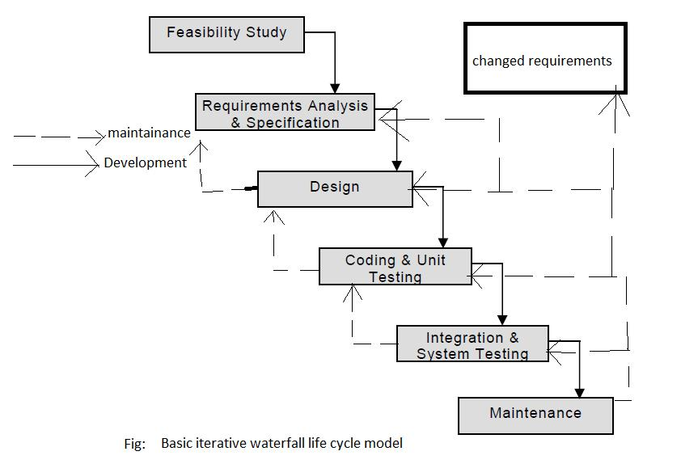
I T E R A T I V E W A T E R F A L L M O D E L

Slide 61
I T E R A T I V E W A T E R F A L L M O D E L
This waterfall model allows us to correct the error committed during the developmental phase.
The principle of detecting errors as close to their point of introduction as possible is known as phase containment of errors.
These errors are not possible to be always detected at their point of occurrence.
But, they must be detected as they are possible, because finding the errors at higher stage causes entire system testing hence cost is increased/high

Slide 62
P R O T O T Y P I N G M O D E L S

Slide 63
P R O T O T Y P I N G M O D E L S
This model specify that before the actual system is being built the working model or the prototype system should be built in.
Prototype means dummy
It is a modern and advance implementation system with limited functional capabilities & is comparatively inefficient with the actual system

Slide 64
P H A S E S O F P R O T O T Y P I N G M O D E L S
Communication
Quick plan
Modeling & quick design
Construction of prototype
Deployment, delivery & feedback

Slide 65
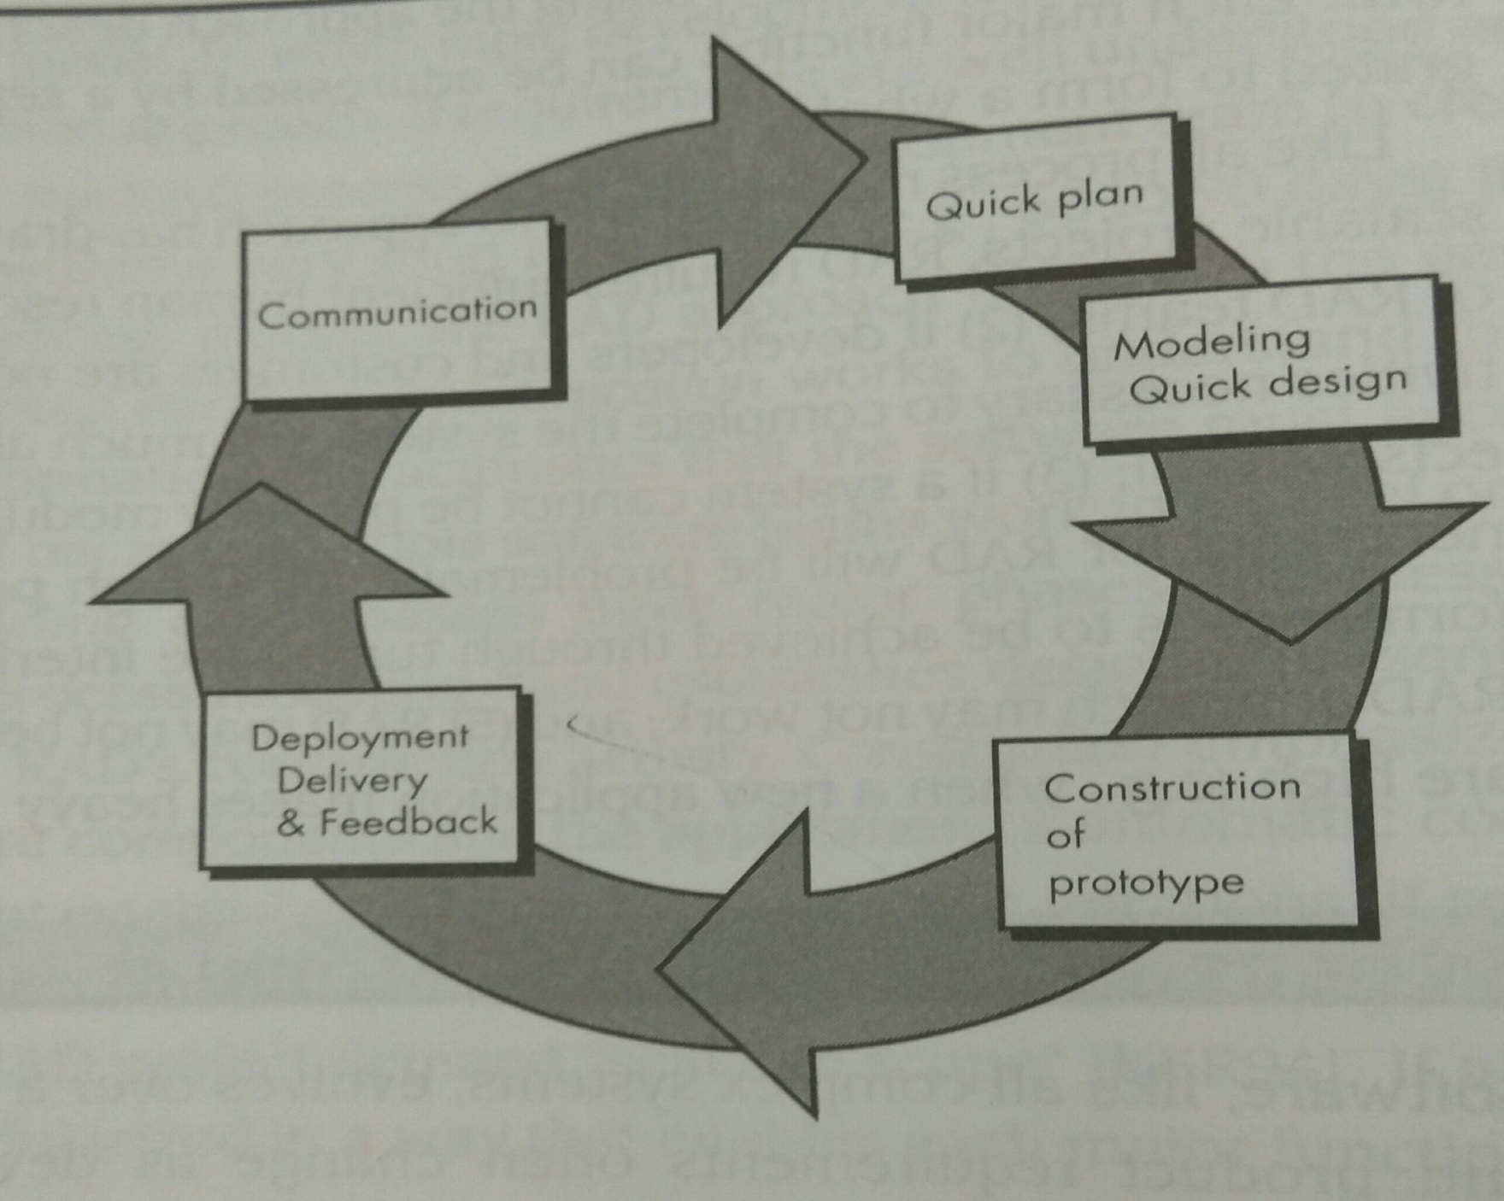
P H A S E S O F P R O T O T Y P I N G M O D E L S

Slide 66
C O M M U N I C A T I O N
Software engineer & customer meet, and define the overall objectives of Software
Identify whatever requirements are known
Outline the areas whether further definition is mandatory

Slide 67
Q U I C K P L A N
A prototyping iteration is planned quickly
A quick plan is generated based on the gathered requirements

Slide 68
M O D E L I N G Q U I C K D E S I G N
In this phase a model or design is created quickly
This design focus on representation of aspects of the software that is visible to the user
Eg: human interface layout, output display formats

Slide 69
C O N S T R U C T I O N O F P R O T O T Y P E
After the quick design phase, a prototype is constructed based on the quick design

Slide 70
D E P L O Y M E N T D E L I V E R Y & F E E D B A C K
Prototype is deployed & evaluated by the customer
Feedback is collected from the customer
This feedback is used to refine the software requirements
Iteration occurs as the prototype is tuned to satisfy the needs of the customer
This helps the developer to understand what needs to be done

Slide 71
A D V A N T A G E S
Increased user involvement in the product even before its implementation.
Since a working model of the system is displayed, the users get a better understanding of the system being developed.
Reduces time and cost as the defects can be detected much earlier.
Quicker user feedback is available leading to better solutions.
Missing functionality can be identified easily.
Confusing or difficult functions can be identified.
Users get a feel for the actual system
Developers get to build something immediately

Slide 72
D I S A D V A N T A G E S
Affects the overall s/w quality & long term maintainability
Customer gets a partially working version of the s/w
Due to the rush to get a working prototype, quality of s/w is ignored
Developer makes compromises on implementation to get the working prototype quickly
He may use a inefficient algorithm, or programming language for quick demonstration
Users may get confused in the prototypes and actual systems.
The effort invested in building prototypes may be too much if it is not monitored properly.

Slide 73
I N C R E M E N T A L M O D E L S

Slide 74
I N C R E M E N T A L M O D E L S
Incremental model also known as Evolutionary model
It is based upon principle of incremented developments of the functional unit & then integrating it for visible.
Each incremental version is tested individually before being integrated into the system.

Slide 75
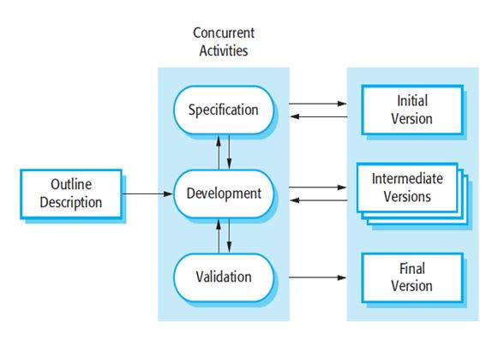
I N C R E M E N T A L M O D E L S [2]

Slide 76
I N C R E M E N T A L M O D E L S [3]
Software evolves over a period of time
Its an idea of considering initial requirements and developing initial implementation of system also called initial version
Implementation is then discussed with the customer and his comment are analyzed and intermediate version are built and released
The implementation is later further fine tuned till customer is happy with the system and the final version is released

Slide 77
A D V A N T A G E S
Customers do not have to wait until the entire s/m is delivered
The first increment satisfies their most critical requirements so they can use the s/w immediately
Customers can use early increments as prototypes
They can gain experience that informs their requirements for later increments
Lower risk of overall project failure
Core functions will get more testing
Core functions are delivered first
So they will get more amt of testing
As the individual module takes place, so final product will contain limited amount of errors.

Slide 78
A D V A N T A G E S
Generates working software quickly and early during the software life cycle.
More flexible--less costly to change scope and requirements.
Easier to test and debug during a smaller iteration.
Each iteration is an easily managed milestone.
Lower risk of overall project failure
Core functions will get more testing
As the individual module takes place, so final product will contain limited amount of errors.

Slide 79
D I S A D V A N T A G E S
It is only helpful for large software products because we can find individual modules for incremental implementation.
Increments should be small & each increments should deliver some system functionality
Difficult to map customer requirements into increments of right size
Hard to identify common facilities needed by all increments
Requirements are not defined in detail until an increment is implemented

Slide 80
Mostly such model is used in web applications and product based companies.

Slide 81
S P I R A L M O D E L

Slide 82
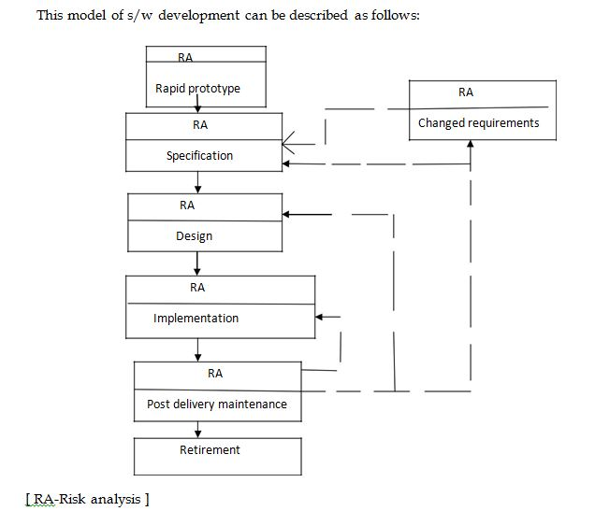
S P I R A L M O D E L

Slide 83
S P I R A L M O D E L [2]
This model contains the elements from all the other life cycle model along with the necessary risks involves in each of the developmental phase.
So it is called as meta model.

Slide 84
S P I R A L M O D E L [3]
The spiral model is a risk-driven where the process is represented as spiral rather than a sequence of activities.
It was designed to include the best features from the waterfall and prototyping models, and introduces a new component; risk-assessment.
Each loop in the spiral represents a phase.

Slide 85
S P I R A L M O D E L [3]
Thus the first loop might be concerned with system feasibility, the next loop might be concerned with the requirements definition, the next loop with system design, and so on.
The representation of this model looks a spiral with many loops
No: of loops in the model is not fixed
Varies from project to project

Slide 86
P H A S E S O F S P I R A L M O D E L
Each phase in the spiral model is split into 4 quadrants
Objective setting
Risk assessment and reduction
Development and validation
Planning

Slide 87
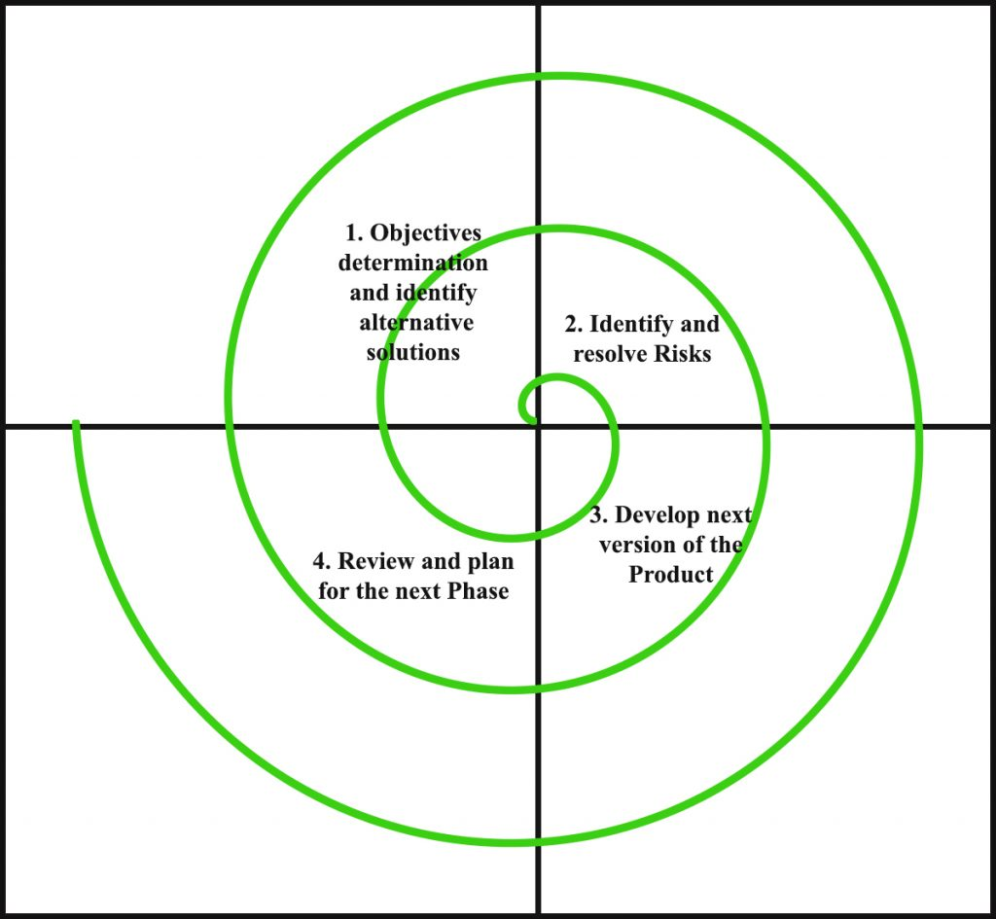
P H A S E S O F S P I R A L M O D E L

Slide 88
Q U A D R A N T – 1: O B J E C T I V E S E T T I N G
The objectives and risks for that phase of the project are defined

Slide 89
Q U A D R A N T 2: R I S K A S S E S S M E N T A N D R E D U C T I O N
For each of the identified project risks, a detailed analysis is conducted, and steps are taken to reduce the risk.
For example, if there’s a risk that the requirements are inappropriate, a prototype may be developed.

Slide 90
Q U A D R A N T 3 : D E V E L O P M E N T A N D V A L I D A T I O N
After risk evaluation, a process model for the system is chosen.
So if the risk is expected in the user interface then we must prototype the user interface.

Slide 91
Q U A D R A N T 4 : P L A N N I N G
The project is reviewed and a decision is made whether to continue with a further loop or not.

Slide 92
R I S K H A N D L I N G I N S P I R A L M O D E L
Risk is an adverse circumstance that hamper the successful completion of the s/w project
Eg: accessing data from a remote database is too slow
Solution
Build a prototype of data access subsystem & experiment it with exact access rate
Implement a caching scheme or faster communication scheme to overcome the risk’
Risk resolution can be done by using a prototype
Prototype help in evaluating the pros & cons of a solution in a faster & inexpensive manner
Spiral model cope up with risks by building a prototype in each phase

Slide 93
A D V A N T A G E S
Changing requirements can be accommodated.
Allows extensive use of prototypes.
Requirements can be captured more accurately.
Users see the system early.
Development can be divided into smaller parts and the risky parts can be developed earlier which helps in better risk management.
More powerful than prototype model
Risks are resolved by building prototype before actual development starts

Slide 94
D I S A D V A N T A G E S
Management is more complex.
End of the project may not be known early.
Not suitable for small or low risk projects and could be expensive for small projects.
Process is complex
Spiral may go on indefinitely.
Large number of intermediate stages requires excessive documentation.
More complicated phase structure
Project team must have knowledgeable & experienced staff
Not suitable for outsourced project
Coz risks need to be continually assessed

